Slide 1
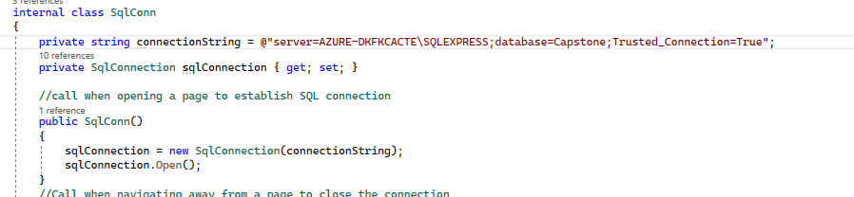
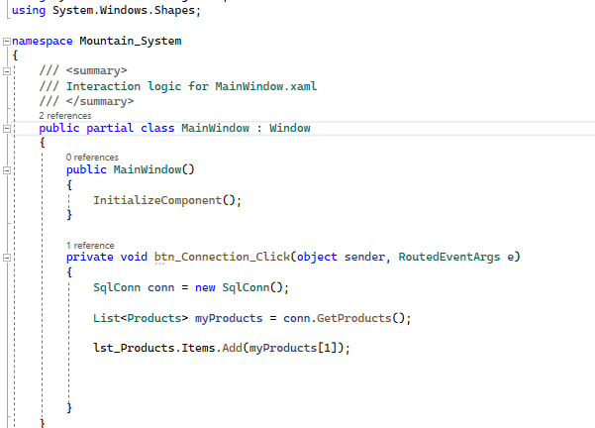
I modified the connectionString.
I created a btn_Connection_Click just to add one product in a ListView.

Slide 2
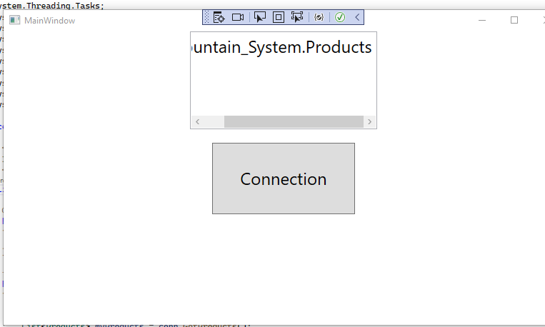
I don’t get any product item when I click the Connection button.
I figure I’m doing something wrong that’s pretty basic. Might you enlighten me?

